Slide 1


Paired t-test

Slide 2
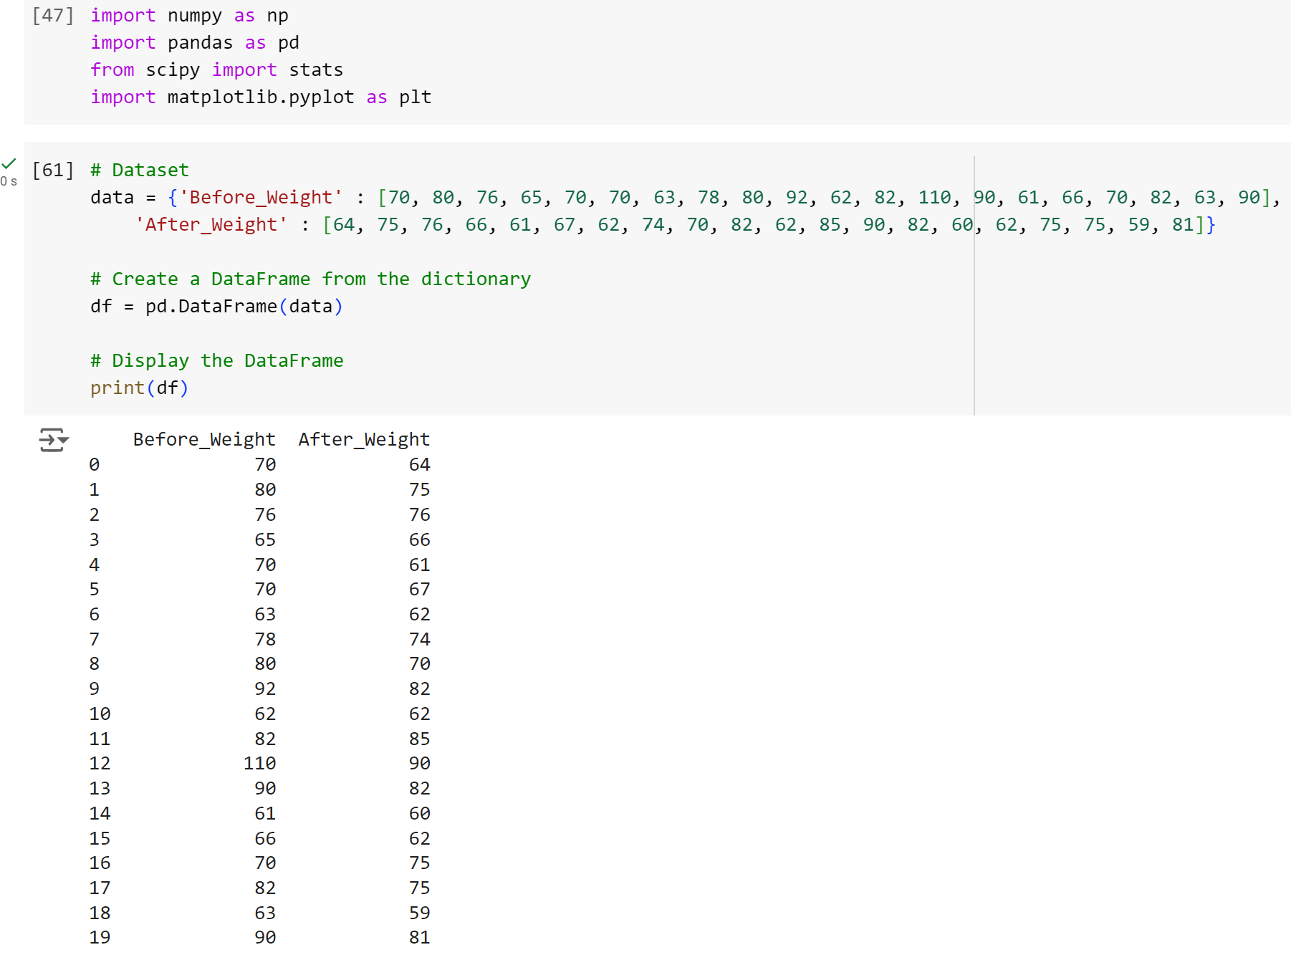
Null Hypothesis (H₀): There is no significant difference between the body weight before and after the diet.
H0: μBefore = μAfter
Alternative Hypothesis (H₁): There is a significant difference between the body weight before and after the diet.
→ H1: μBefore ≠ μAfter

Slide 3
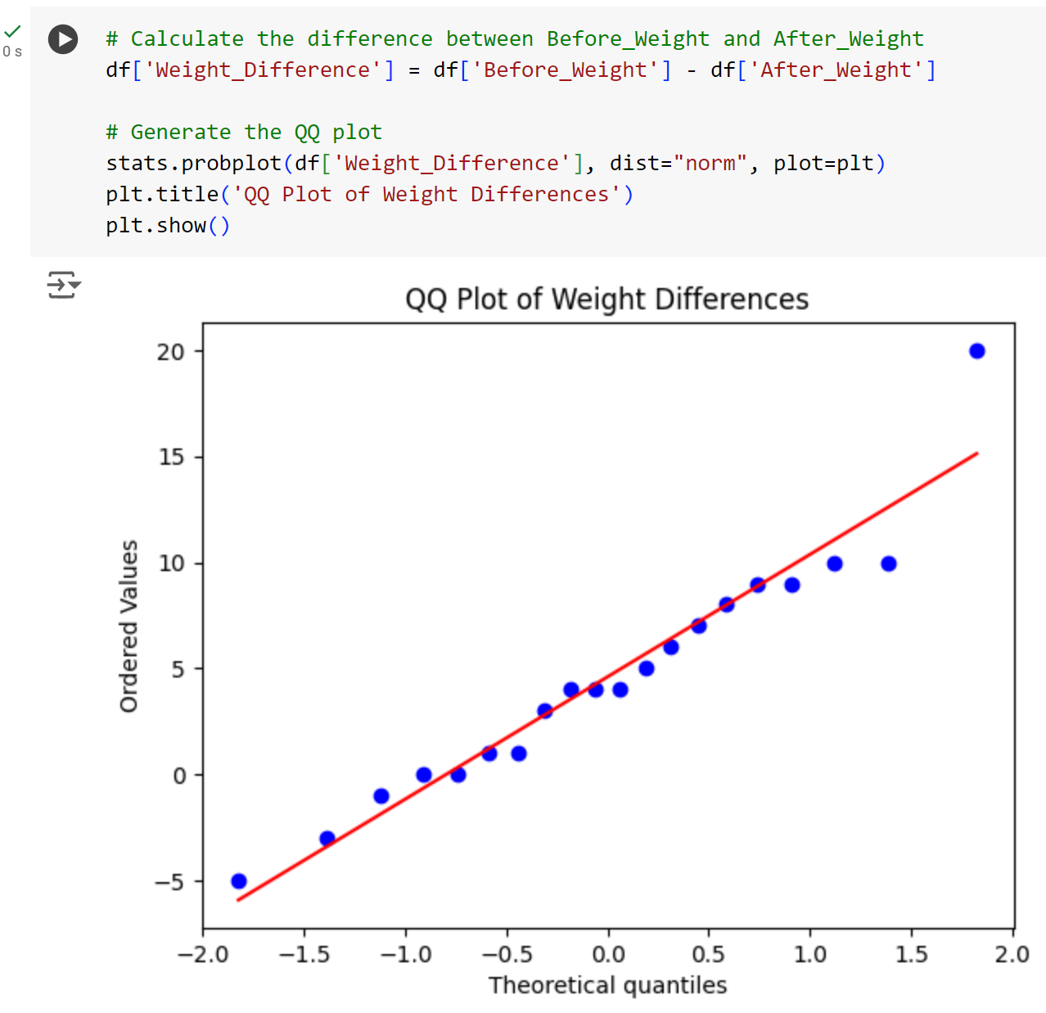
Normality test 1 : QQ plot

Slide 4
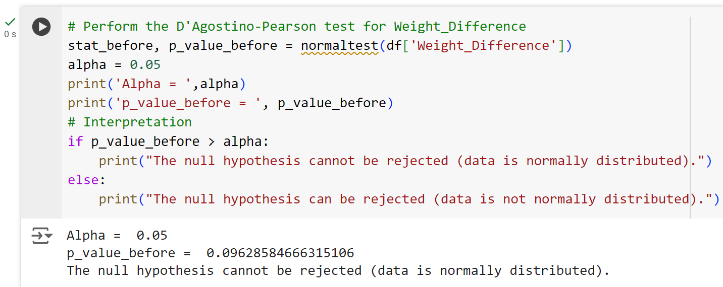
Normality test 2 : D’Agostino-Pearson

Slide 5
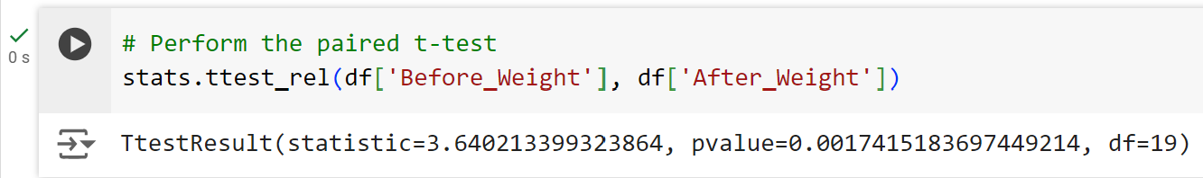
Conclusion:
The p-value obtained is less than 0.05 (specifically 0.0017), therefore the null hypothesis is rejected. This indicates, with 95% confidence, that there exists a statistically significant difference in body weight before and after the diet.

